Slide 1
Topic 2: Programming Development and its Elements
INTRODUCTION TO PYTHON

Slide 2
Table of contents
01
02
03
04
Software development process
Pseudocode and flowchart
Input and output from keyboard
Elements of program

Slide 3
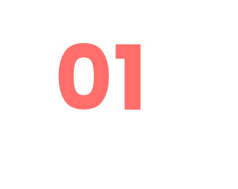
Software development process !

Slide 4
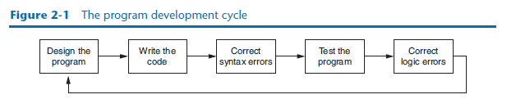

Slide 5
02
Pseudocode and flowchart

Slide 6
FLOWCHART
A flowchart is a diagram that graphically represents the steps that take place in a program.
Oval
Parallelogram
Rectangle

Slide 7
The ovals, which appear at the top and bottom of the flowchart, are called terminal
symbols. The Start terminal symbol marks the program’s starting point, and the End
terminal symbol marks the program’s ending point.
Parallelograms are used as input symbols and output symbols. They represent steps
in which the program reads input or displays output.
Rectangles are used as processing symbols. They represent steps in which the program
performs some process on data, such as a mathematical calculation.
The symbols are connected by arrows that represent the “flow” of the program. To step through the symbols in the proper order, you begin at the Start terminal and follow the arrows until you reach the End terminal.
Diamonds are used as a decision symbols

Slide 8
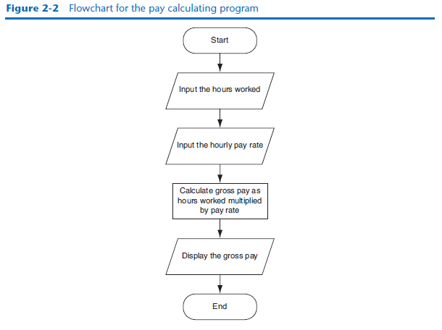

Slide 9
03
ELEMENTS OF PROGRAM

Slide 10
TYPES OF ELEMENTS OF PROGRAM
Comments
Statements
Variables
Data Types
Functions

Slide 11
COMMENTS
Comments are used to provide information about the code and are not executed by the interpreter. They are useful for documentation and clarification. In Python, you can use the '#' symbol to start
Program 2-5 (comment1.py)
1 # This program displays a person's
2 # name and address.
3 print('Kate Austen')
4 print('123 Full Circle Drive')
5 print('Asheville, NC 28899')
Program Output
Kate Austen
123 Full Circle Drive
Asheville, NC 28899

Slide 12
STATEMENTS
Python is an imperative programming language, so statements are the building blocks of a program.
They perform specific actions or tasks.
Examples of statements include variable assignments, function calls, conditional statements (if-else), loops (for and while),

Slide 13
VARIABLES
Variables are used to store data values. In Python, you can create a variable by assigning a value to a name. For example, x = 10 creates a variable named "x" with a value of 10.
A variable is a name that represents a storage location in the computer’s memory.
An assignment statement is written in the following general format:
variable = expression.
The equal sign (=) is known as the assignment operator. In the general format, variable is the name of a variable and expression is a value, or any piece of code that results in a value.

Slide 14
VARIABLES
(variable_demo2.py)
1 # Create two variables: top_speed and distance.
2 top_speed = 160
3 distance = 300
4
5 # Display the values referenced by the variables.
6 print('The top speed is')
7 print(top_speed)
8 print('The distance traveled is')
9 print(distance)
Program Output
The top speed is
160
The distance traveled is
300
>>> width = 10 Enter
>>> length = 5 Enter
>>> print(width) Enter
10
>>> print(length) Enter
5
>>> print('width') Enter
width
>>> print(width) Enter
10
(variable_demo.py)
1 # This program demonstrates a variable.
2 room = 503
3 print('I am staying in room number')
4 print(room)
Program Output
I am staying in room number
503

Slide 15
DATA TYPES
Uses data types to categorize values in memory. When an integer is stored in memory, it is classified as an int, and when a real number is stored in memory, it is classified as a float.
Data Types: Python supports various built-in data types, including:
Numeric types: int, float, complex
Sequence types: list, tuple, range
Text type: str
Mapping type: dict
Set types: set, frozenset
(string_variable.py)
1 # Create variables to reference two strings.
2 first_name = 'Kathryn'
3 last_name = 'Marino'
4
5 # Display the values referenced by the variables.
6 print(first_name, last_name)
Program Output
Kathryn Marino

Slide 16
FUNCTIONS
Functions are reusable blocks of code that perform a specific task. They help in organizing code and promoting code reusability.
You can define your own functions or use built-in functions provided
Displaying Output with the print Function
CONCEPT: You use the print function to display output in a Python program.
1 print(“Navitha Gunalan")
2 print(“Lecturer")
3 print(“Disted College")
Program Output
Navitha Gunalan
Lecturer
Disted College

Slide 17
04
INPUT AND OUTPUT FROM KEYBOARD

Slide 18
INPUT AND OUTPUT FROM KEYBOARD
variable = input(prompt)
In the general format, prompt is a string that is displayed on the screen. The string’s purpose is to instruct the user to enter a value; variable is the name of a variable that references the data that was entered on the keyboard. Here is an example of a statement that
name = input('What is your name? ')
When this statement executes, the following things happen:
• The string 'What is your name? ' is displayed on the screen.
• The program pauses and waits for the user to type something on the keyboard and
then to press the Enter key.
• When the Enter key is pressed, the data that was typed is returned as a string and
assigned to the name variable.

Slide 19
INPUT AND OUTPUT FROM KEYBOARD
1 # Get the user's first name.
2 first_name = input('Enter your first name: ')
3
4 # Get the user's last name.
5 last_name = input('Enter your last name: ')
6
7 # Print a greeting to the user.
8 print('Hello', first_name, last_name)
Program Output (with input shown in bold)
Enter your first name: Vinny Enter
Enter your last name: Brown Enter
Hello Vinny Brown
1 # Get the user's name, age, and income.
2 name = input('What is your name? ')
3 age = int(input('What is your age? '))
4 income = float(input('What is your income? '))
5
6 # Display the data.
7 print('Here is the data you entered:')
8 print('Name:', name)
9 print('Age:', age)
10 print('Income:', income)
Program Output (with input shown in bold)
What is your name? Chris Enter
What is your age? 25 Enter
What is your income? 75000.0
Here is the data you entered:
Name: Chris
Age: 25
Income: 75000.0

Slide 20
Thanks!
Any Questions?

